Slide 1

African Forum on Science, Technology and Innovation
2 April 2012
CENTER FOR SCIENCE, TECHNOLOGY, AND SOCIETY
SANTA CLARA UNIVERSITY
John Kohler, Director of Social Capital Programs

Slide 2
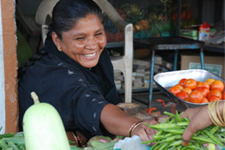
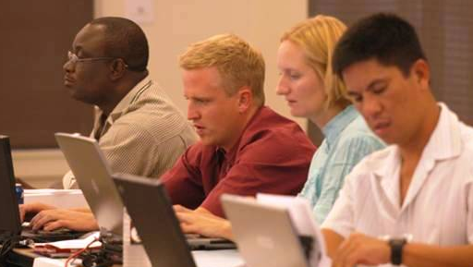
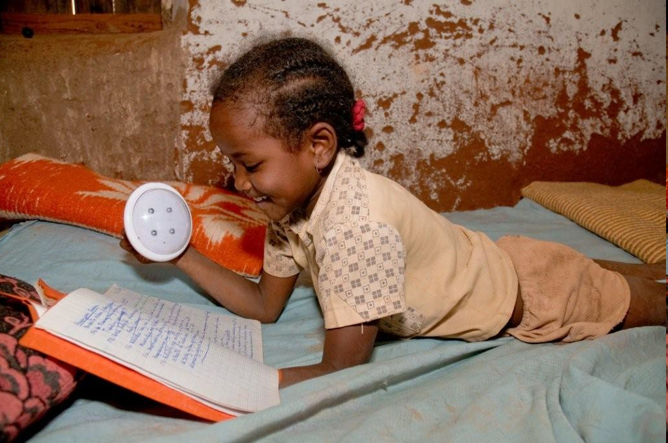
Center Strategy
MISSION
Promote the use of science and technology
to benefit underserved communities worldwide.
BHAG (BIG, HAIRY, AUDACIOUS GOAL)
Positively impact the lives of 1 billion people by 2020.
Notes:
2

Slide 3
CENTER STRATEGY
VALUE PROPOSITION
We help socially-minded entrepreneurs build sustainable and scalable organizations that maximize social impact by linking them to Silicon Valley acumen.
TARGET MARKET
Field-based social entrepreneurs serving base-of-pyramid communities around the world.
STRUCTURE
Multiple dimensions, aggressive use of technology
Notes:
Signature program is the Global Social Benefit Incubator

Slide 4
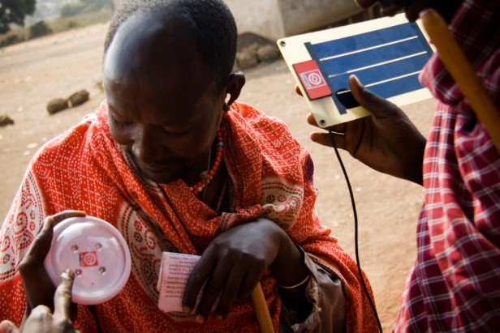
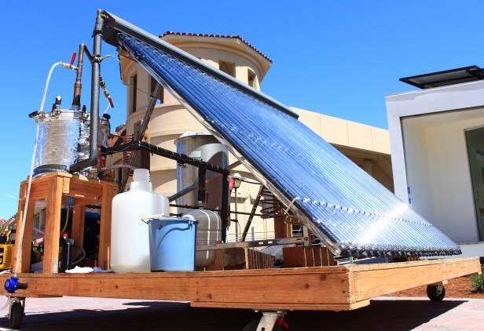
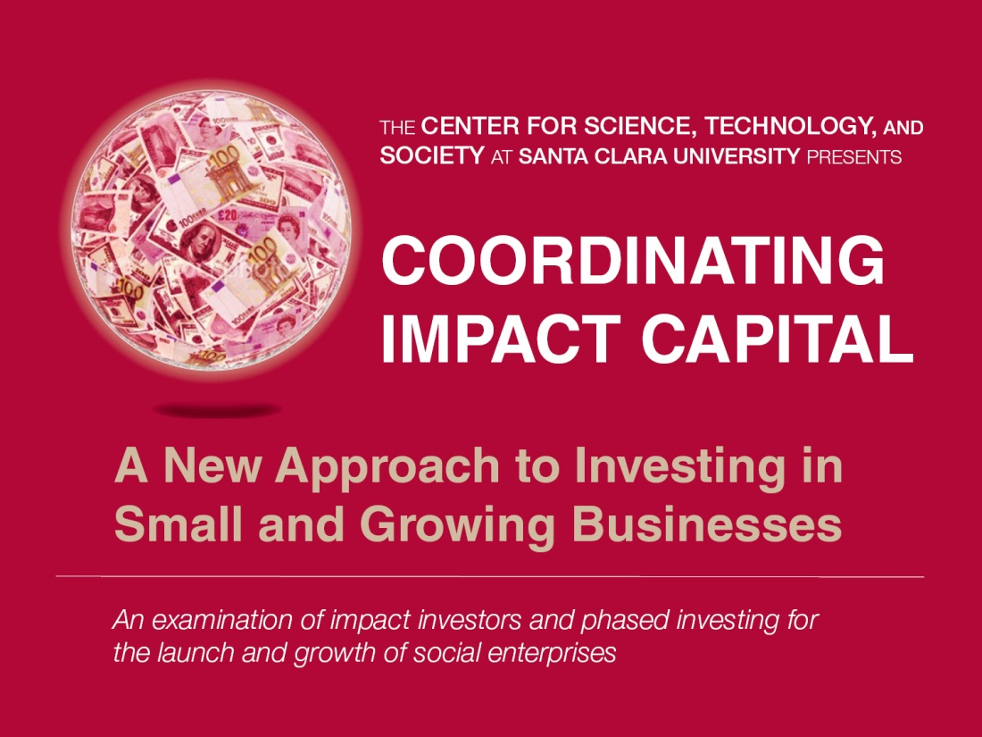
Social benefit Programs
GOAL
Enable social enterprises to scale, creating systemic change for the poor.
Entrepreneurship
Innovation
Social Capital
STUDENT AND FACULTY ENGAGEMENT
Notes:
4
Center aims to help through 3 programs
GSBI signature program: sustainable, scalable businesses that serve as nuclei for economic growth, including accelerating access to capital
Frugal innovation lab. Appropriate—rugged, affordable, simple—for the “base of pyramid” communities which are emerging markets
Social capital or impact investing to accelerate ventures scaling
Student and faculty engagement in all of these social benefit programs

Slide 5
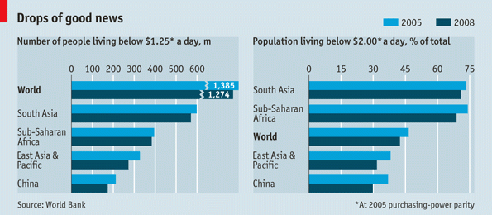
WHERE is ‘economic lift’ needed?

Slide 6
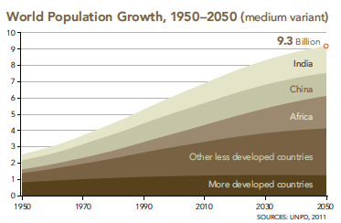
DEVELOPING WORLD =
EMERGING MARKETS

Slide 7
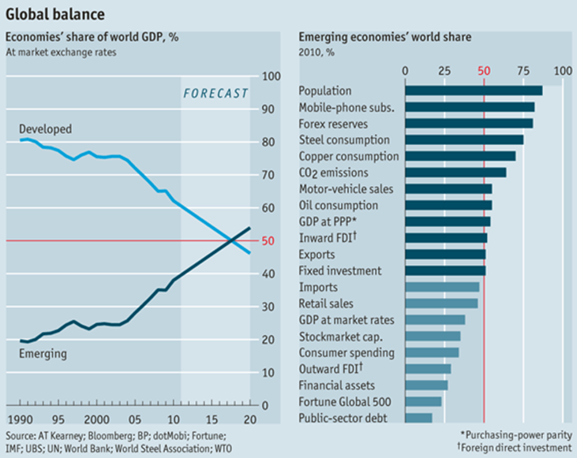

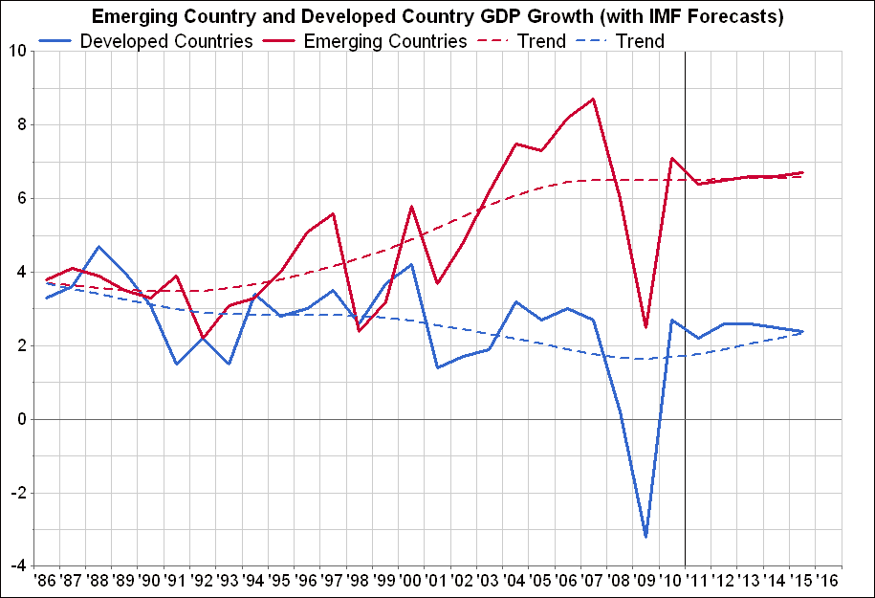
EMERGING MARKETS

Slide 8
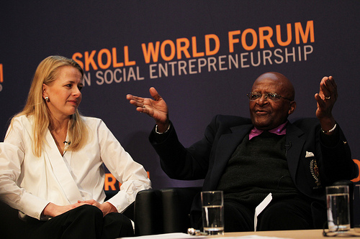
What are Social Entrepreneurs?
  So•cial En•tre•pre•neurs
  [soh-shuhl ahn-truh-pruh-nurs] (noun)
  Society’s change agents.
  Creators of innovations that disrupt the status quo and transform our world for the better.
“You make one proud of being human.”
− Archbishop Desmond Tutu
at the 2011 Skoll World Forum
Notes:
I’ll use the term “social entrepreneur” a lot, borrowed this definition from Skoll Foundation
Opportunity to attend SWF at the end of March
Largest gathering
Deep leadership: helping rescue sex slaves in the Philippines, changing the caste system in India, bringing basic health care to people in Haiti
Desmond Tutu addresses the audience, this way: all the problems in the world, Social entrepreneurs make one proud of being human

Slide 9


Our Global Impact
Helped more than 140 social entrepreneurs build sustainable, scalable business models to benefit the lives of more than 74 million people worldwide. 93% of ventures are still operating and 55% are scaling.
Notes:
9
The GSBI is now in its 9th year and metrics are compelling by any standards.
Make most VCs proud.
Social entrepreneurs not always non-profits. Earned income models more sustainable and scalable than contributed revenue.
A few examples.

Slide 10
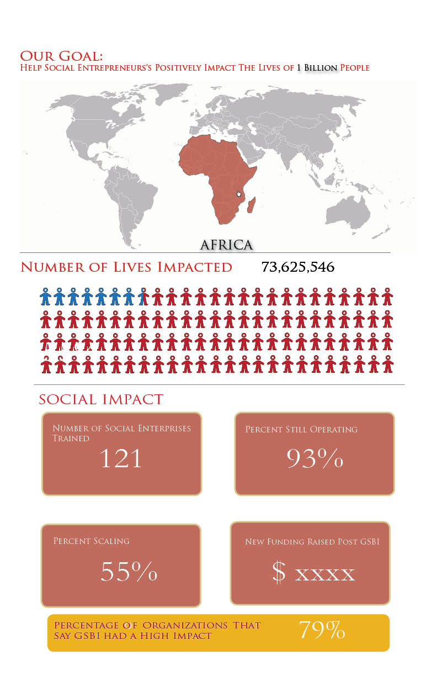
SOCIAL IMPACT METRICS
No universal “benefit”
Impact varies
ROI hard to measure
Three tiers of metrics
  Summary global dashboard
  Sector specific metrics
  Illustrative anecdotes (stories)
Notes:
Summary--standard metrics that we can aggregate, and that collectively measure our impact based on the growth and impact of the SEs we serve.
Sector specific -- this is for benchmarking technologies and business models, with the caveat that differing contextual factors often totally distort these comparisons. give a few examples from clean energy such as installation cost/lumen or kw, lumen/$, $/kwh, etc.
Anecdotes -- Many people are more interested in stories than statistics

Slide 11
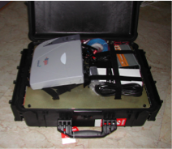
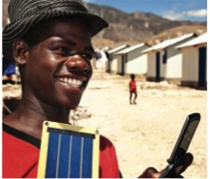
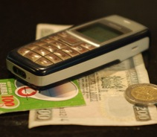
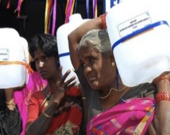
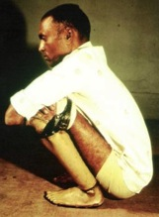

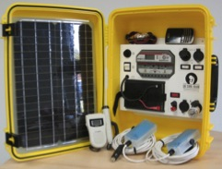
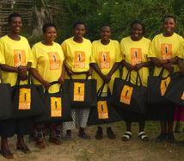
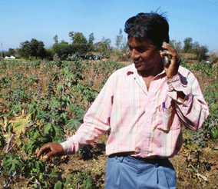
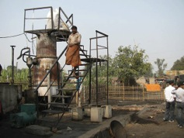
Lightweight
Cisco and NetHope’s Emergency Net-Relief Kit
Ruggedization
Tough Stuff’s highly durable solar panel charging system
Mobile Enabled Solutions
Kopo Kopo mobile money platform
Human Centric Design
Jerry Can for Naandi’s Safe Water Program
FRUGAL
INNOVATION
Affordability
Jaipur Foot $30 prosthetics
Simplification
Tata Chemical’s rice husk water filter
Green Technologies
WE CARE Solar suitcase to light delivery rooms
New Distribution Models
Solar Sisters’ Avon style solar product distribution
Adaptation
Awaaz.De voice message board for education
Use of Local Resources
Husk Power Systems’ rice husk gasification

Slide 12
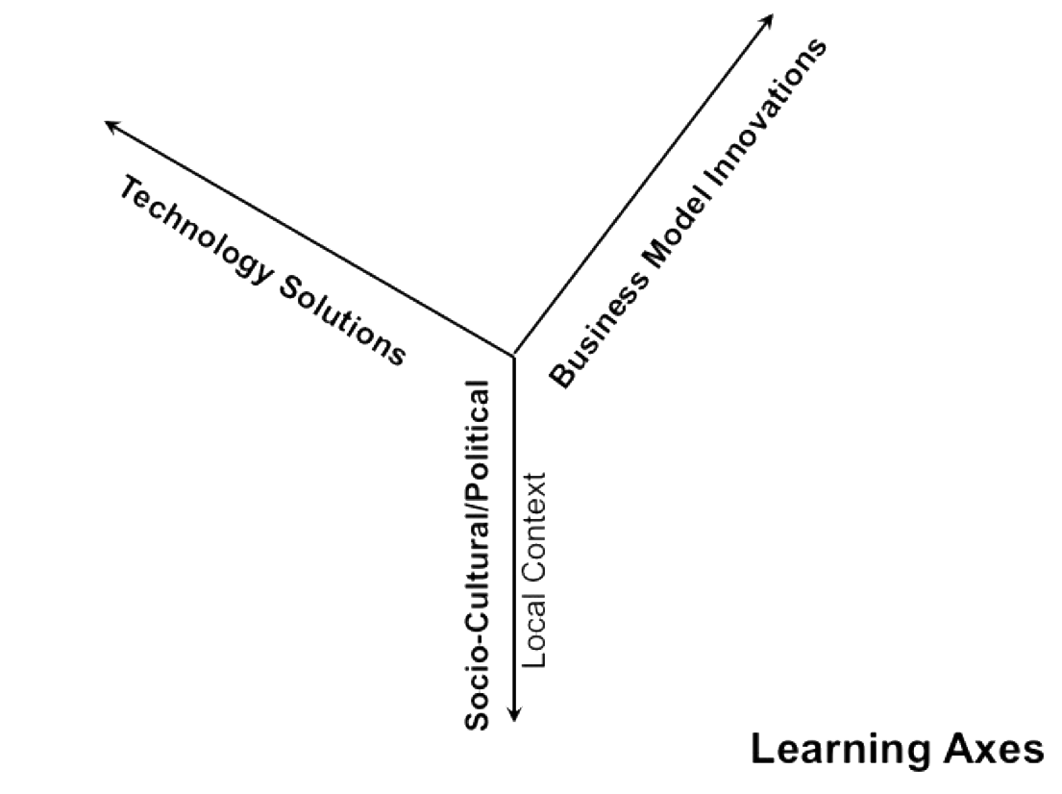
CENTER SECTOR STRATEGY
GSBI
Frugal
Education
SECTOR 1: OFF GRID ENERGY
SECTOR 2: HEALTH
Notes:
Vertical sector focus – deep enough knowledge to learn in at least three dimensions –
Focus rest of my comments today on off-grid, sustainable energy for BoP markets

Slide 13
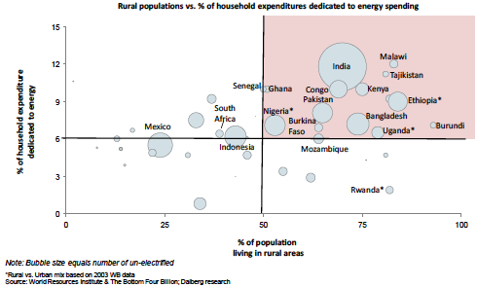
ENERGY POVERTY
Notes:
World Resources Institute
Percent of population living in rural areas
% of household expenditure dedicated to energy 10-15%

Slide 14
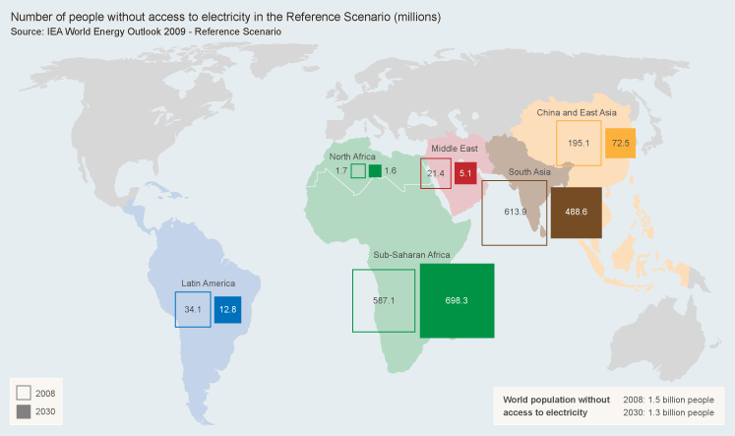
ENERGY POVERTY
Notes:
International Energy Agency – 1.5 B off the grid in 2008
Decline to 1.3 B by 2030, but the number in Africa will actually increase
Grid expansion is not keeping pace with population growth
Off-grid, sustainable energy as a solution for the poor

Slide 15

Energy Map
Notes:
Around the world, social entrepreneurs are pioneering methods to bring affordable renewable energy to these underserved customers. While they currently serve only a fraction of the existing market, the technologies and business models they are developing have the potential, if successfully scaled and replicated, to serve almost everyone.
This site is designed to help you better understand energy delivery for customers underserved by traditional markets, and the technologies and business models being used to help empower the bottom billions.
Best practices in technology and business model innovation
http://energymap-scu.org

Slide 16

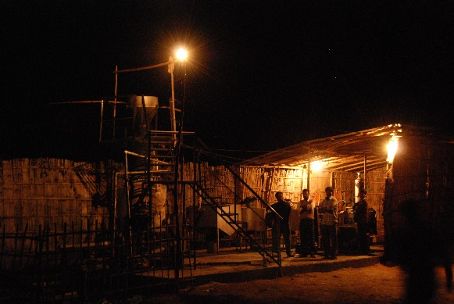

HUSK POWER SYSTEMS
PROBLEM:
125,000 villages
“off the grid” in India, leaving 480 million people without electricity
SOLUTION:
45 million metric tons of rice husks could light 145,000 villages

Slide 17

Paddy
Paddy
Paddy
Village
Paddy
HPS
Stored Husk
Irrigation Pump
Offsets
Rice Mill
Home Clusters
Village
HPS Plant
To Irrigation
CO2
To Households
Village
To Industry
Husk
Offsets
Village
Ash
Revenue
Filters
Village
Gasifier
Generator
Pre-paid Meter
CO2
RHC *
Village
CO2 Broker
CO2
Offsets
Village
Village
RHC = Rice Husk Char
Village
HPS
RHC Refinery
Incense Stick Manufacturing
Village
Notes:
Very complicated value chain but it works – sink carbon
HPS has employed and trained more than 300 local people in rural India for running and managing power plants and saved a total $1.25M in cash for all households HPS serves. By 2014, HPS plans to serve ~ 6,500 villages, save 750,000 tons of CO₂, create 7,000 local jobs and save $50M in cash for over 5 million people by replacing kerosene and diesel with its proprietary renewable energy technology. HPS installs decentralized generation and distribution systems at the cheapest capital cost in the world. At ~$1/W of generation, distribution and installation cost, HPS plants are cheaper than the mega-size Thermal Power Plants. HPS targets setting up of a new paradigm in social entrepreneurship where it pays the community in cash twice the amount it receives from them. Through its mother organization and CSR arm, Samta Samriddhi Foundation, HPS supports and bears the cost of education of over 250 kids.

Slide 18
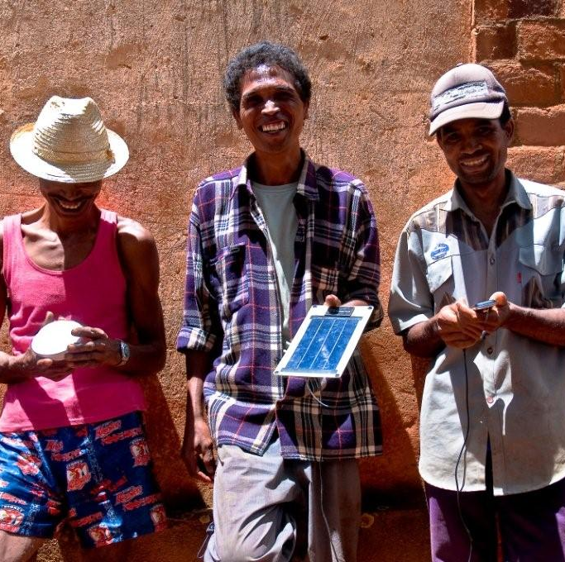
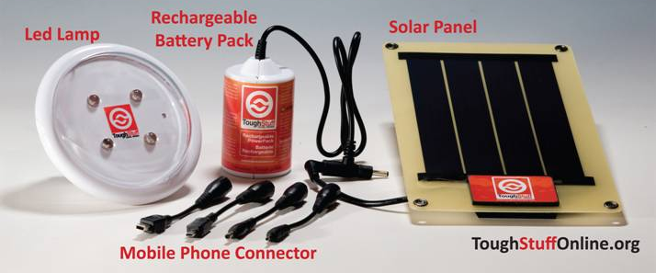
TOUGH STUFF
GLOBAL SOCIAL BENEFIT INCUBATOR 2009
PROBLEM: >500 M people in Africa without electricity. Population growth rate exceeds grid expansion rate. Kerosene and wood are poor solutions for lighting.
SOLUTION: Affordable solar powered energy products for lighting, mobile phone charging, and radios. Payback period of 2-3 months with annual savings of $100/year thereafter. Selling provides local jobs.
“GSBI helped us become ‘investment ready’ and reinforced much of the work we were doing on Impact Assessment.”
- Andrew Tarnswell, Founder
Notes:
18
$0.10-$3.00 per cell phone charge plus traveling all day

Slide 19

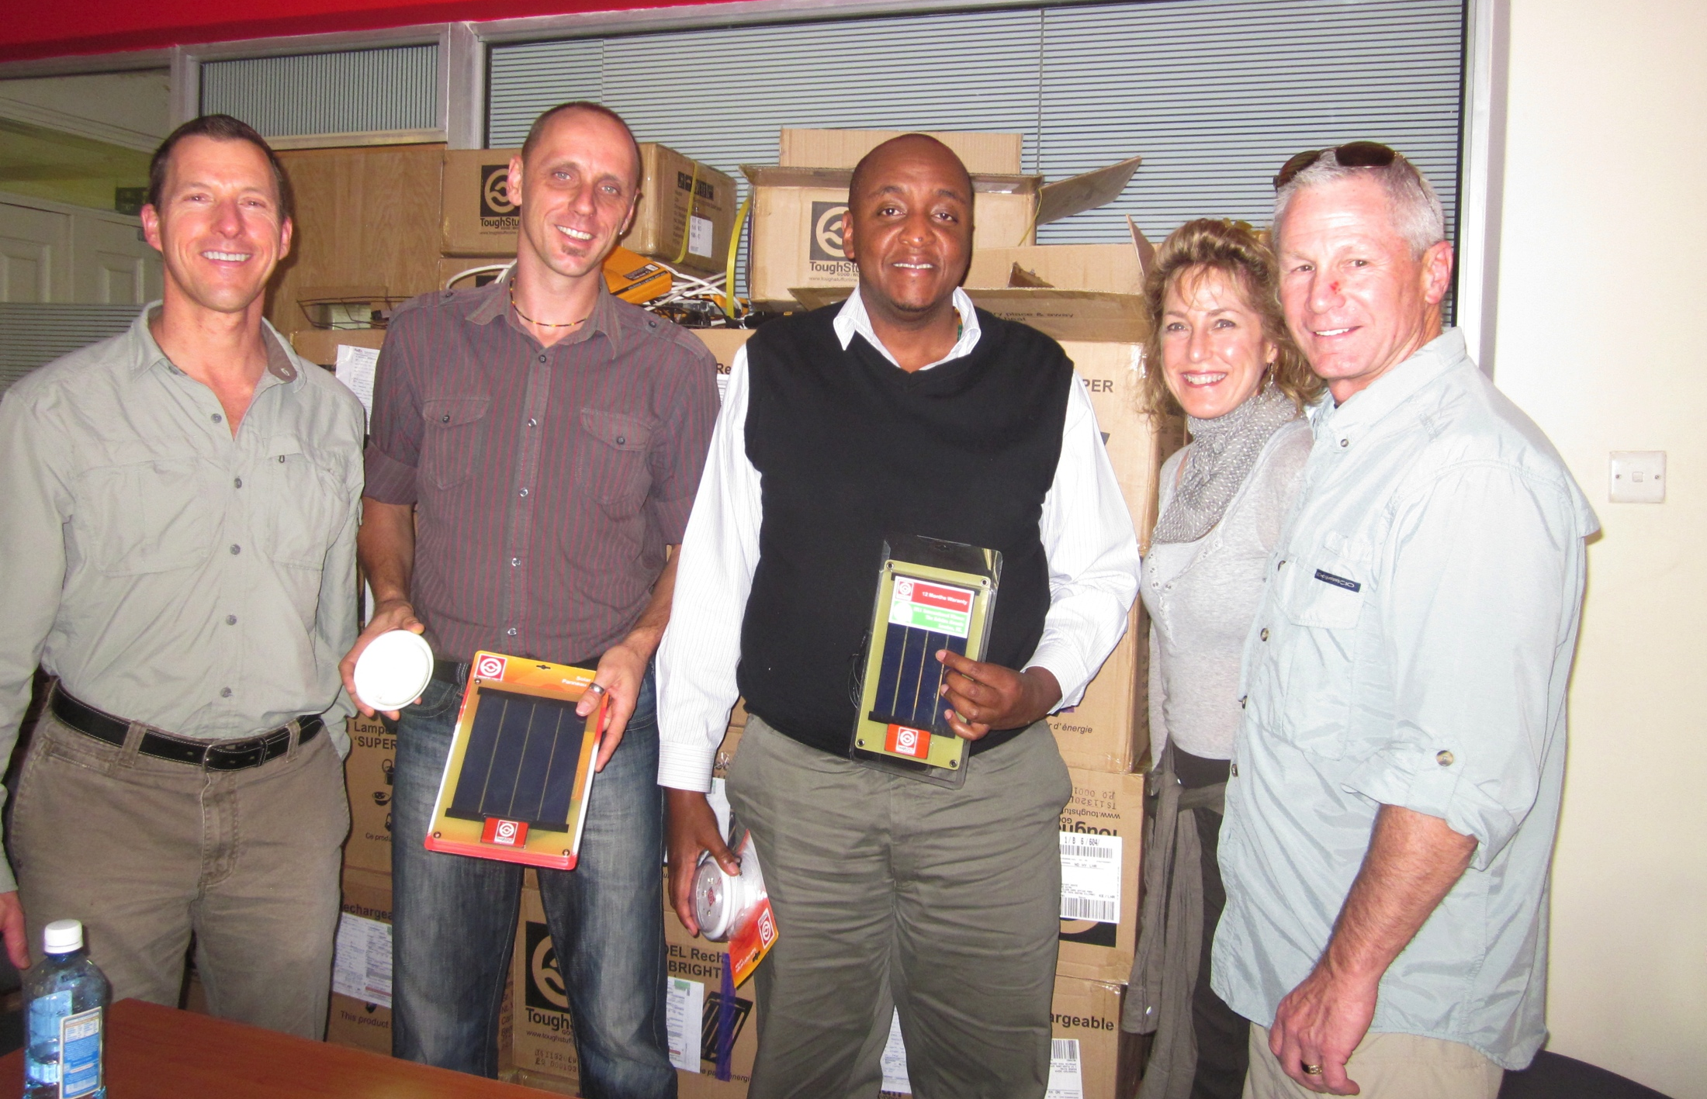
Tough stuff – nairobi

Slide 20

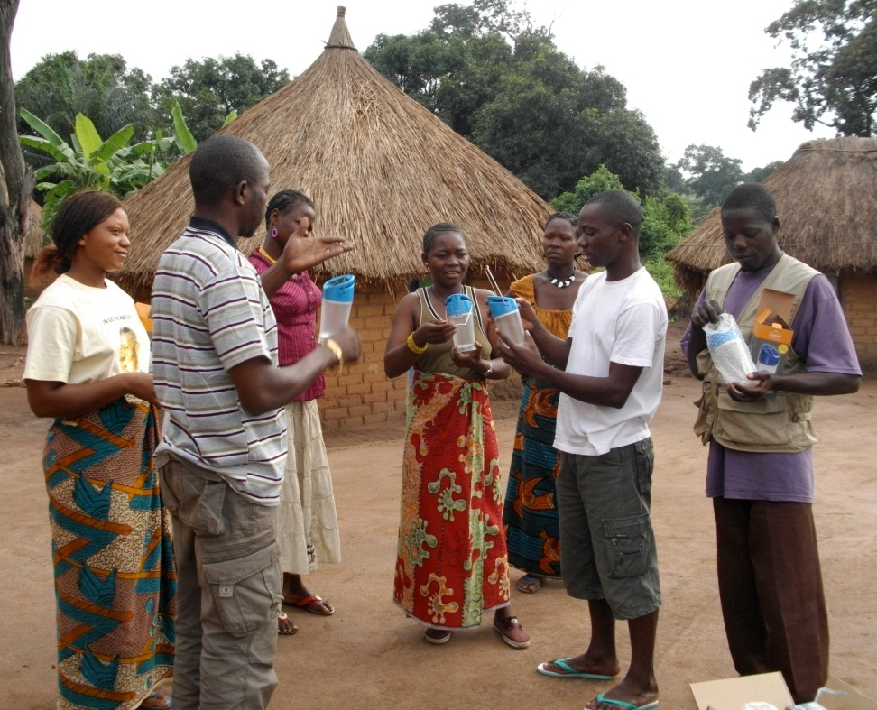

SOLAR SISTER
PROBLEM:
No mechanism to distribute solar powered lanterns to the >500 million people in Africa without electricity
SOLUTION:
An Avon-style network of “Solar Sisters” provides livelihoods and light to families
Notes:
1.5B people live off the electricity grid
$1 Trillion market

Slide 21

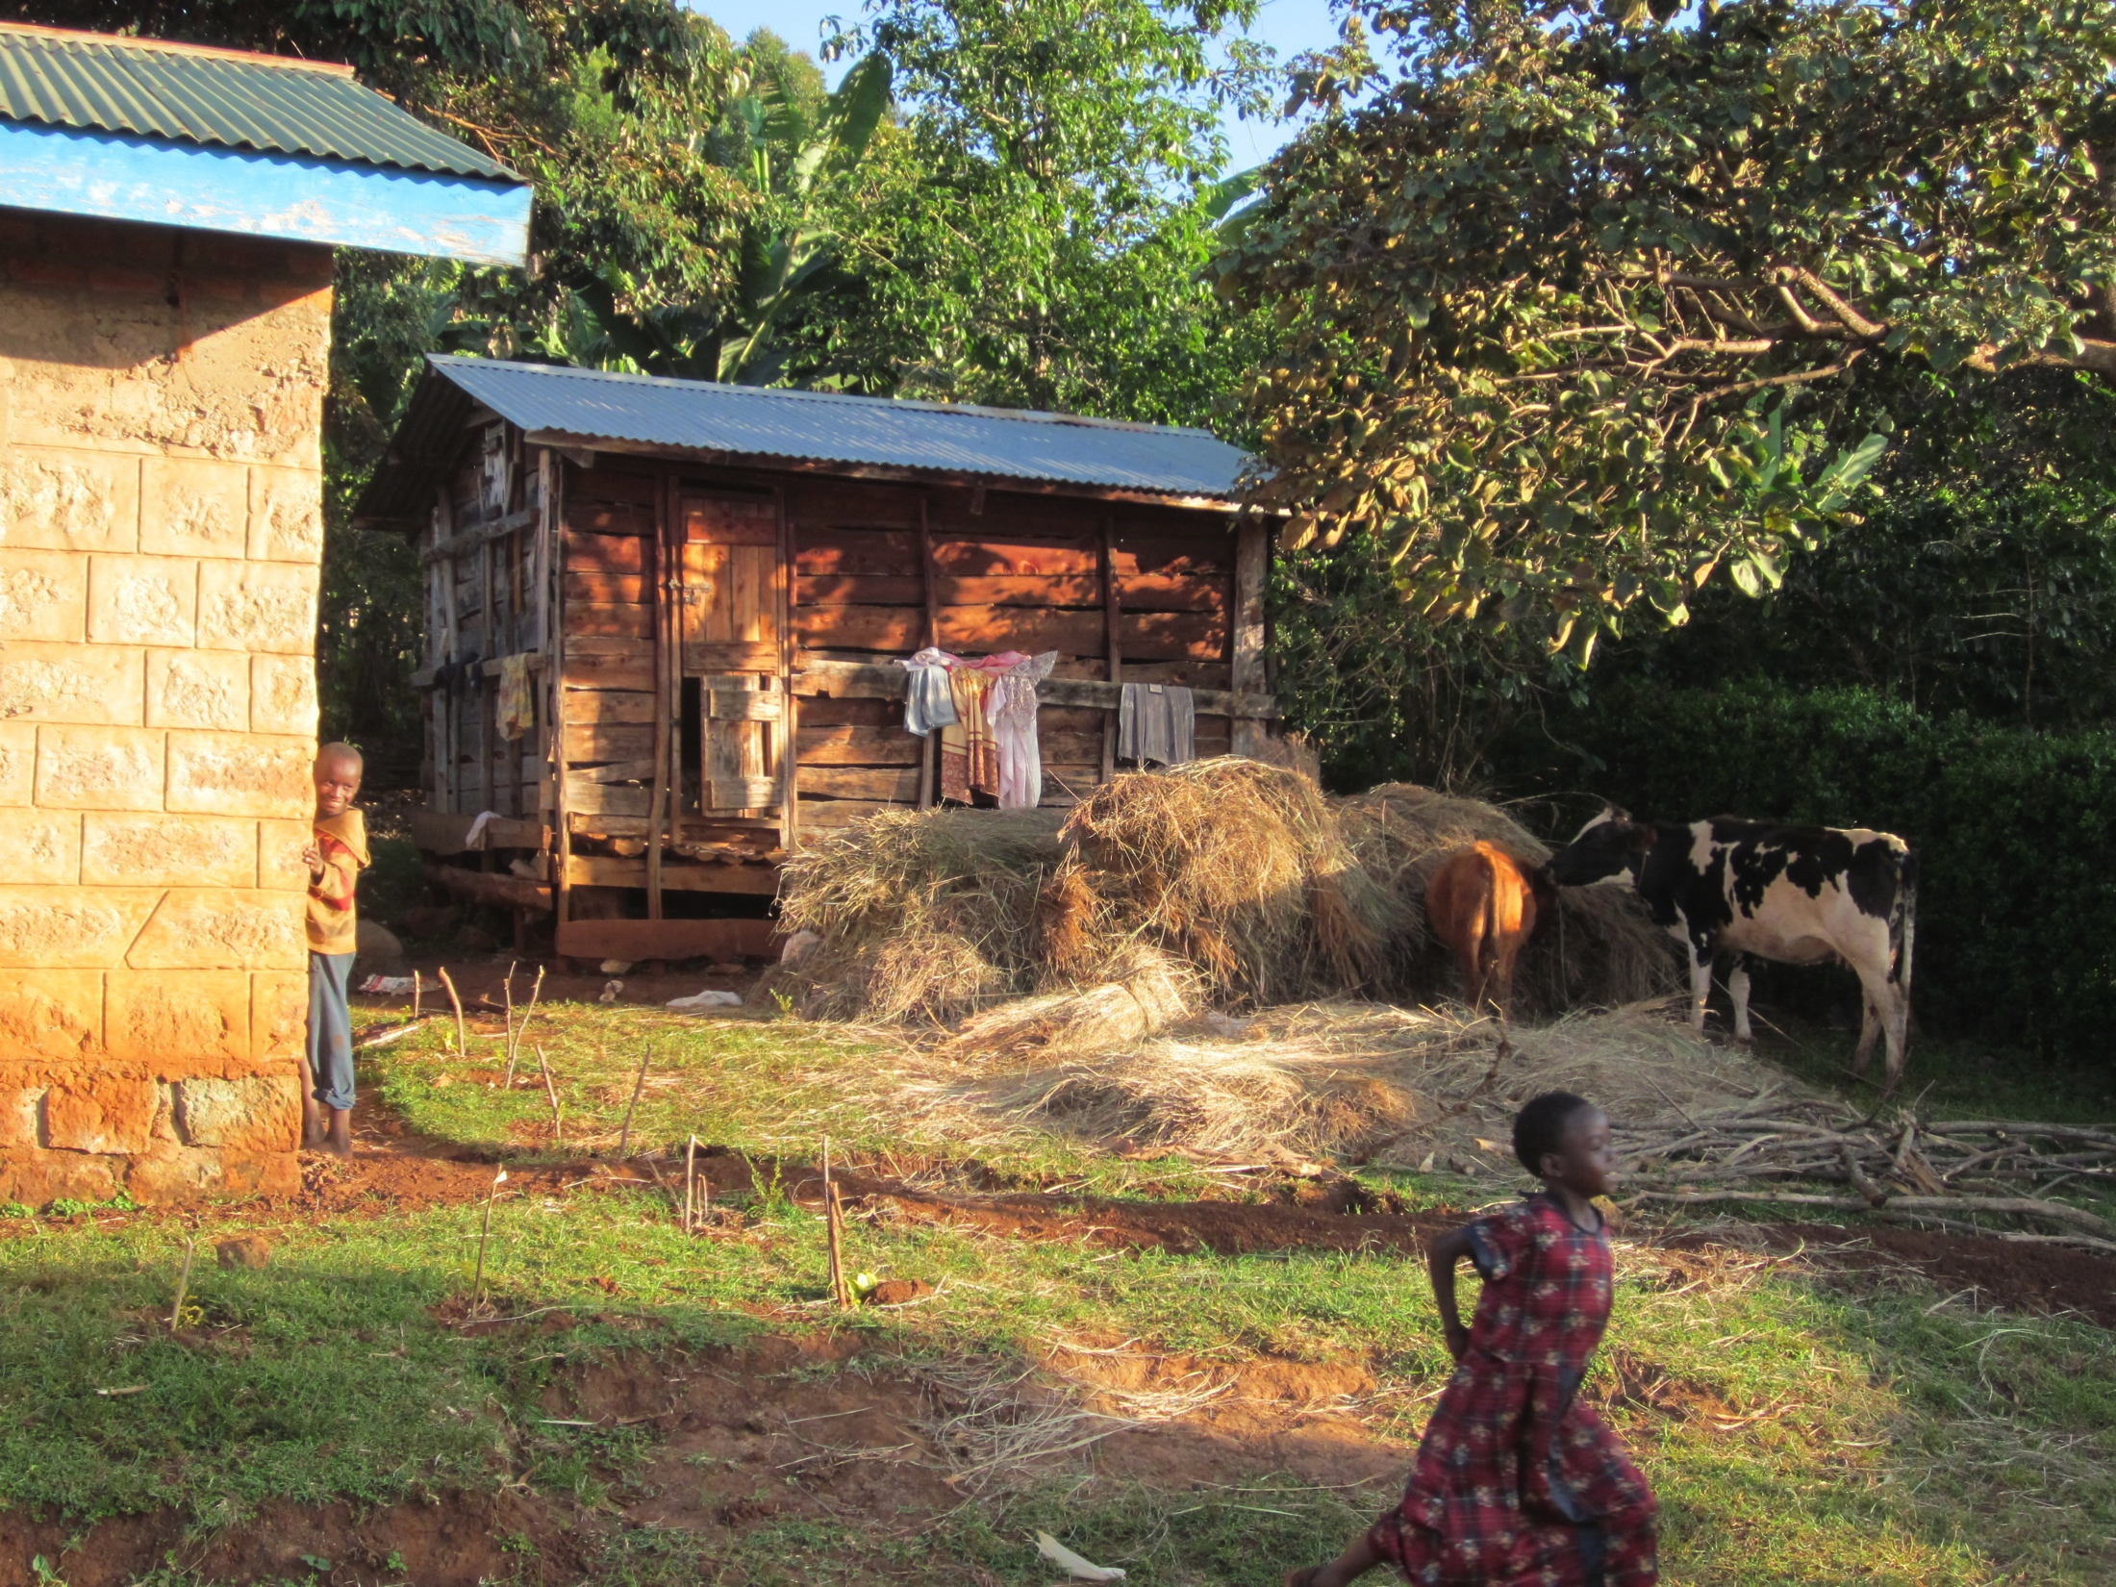
Solar sister – mt. elgon

Slide 22
CONTEXTUAL FACTORS INFLUENCING ADOPTION OF OFF-GRID ENERGY solutions
Import tariffs on solar
Kerosene subsidies
National strategies focused on grid expansion
Carbon market access
Notes:
Import tariffs 20-50% make products unaffordable
36% tariff on LEDs in Namibia
Massive kerosene subsidies
REFITs – favor grid expansion v. off-grid solutions – Uganda: solar a Priority 2 (not priority 1) because of need to connect to the grid
Off-grid solutions are the least costly solution
Carbon market access for social enterprises
Need policies that encourage disruptive, sustainable innovation

Slide 23
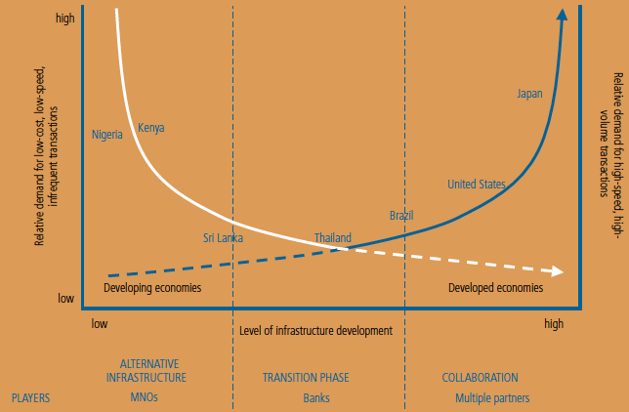
Mobile Money DEMAND CURVES

Slide 24
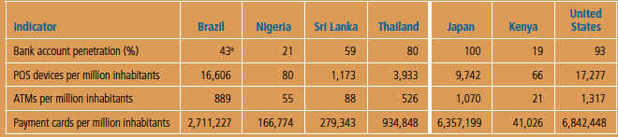
Financial sector development indicators
Kenya and Nigeria have least developed financial services
Sri Lanka and Thailand have a more developed infrastructure
Brazil, Japan, and the US have the most advanced banking structure
Developing countries typically have larger unbanked populations with high demand for low-cost, low-speed weekly or monthly transactions
Developed economies have stronger demand for NFC high volume transactions
Source: IFC Mobile Money Study 2011, Summary Report

Slide 25
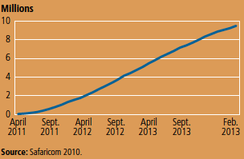
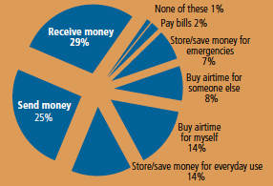
CURRENT AND PROJECTED M-PESA USERS IN KENYA
Kenya population
Launched in 2007
Safari.com 70% market
m-Pesa 83% share
Source: IFC Mobile Money Study 2011, Summary Report

Slide 26


Example
The of Mobile Money
Enterprise
M-Money
M-Money
Kopo Kopo
Platform
Management System
M-Money
M-Money

Slide 27
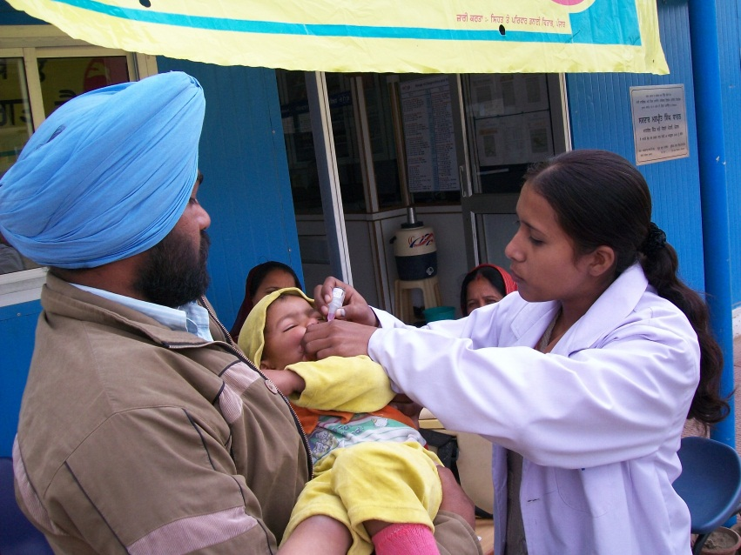

E-Healthpoint
PROBLEM:
No clean water, no medical facilities, no reliable medicines in rural India
SOLUTION:
Provide whole solution: diagnostics, validated pharmaceuticals, clean water, telehealth

Slide 28
BUSINESS MoDEL CHALLENGES
Distribution
Scaling models
Human capital
Financial capital
Notes:
Barriers to broader adoption of technology innovations – business model

Slide 29
IMPACT CAPITAL

Slide 30
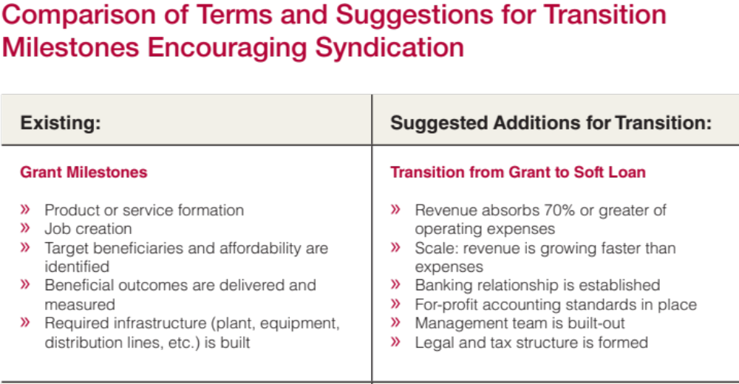

Slide 31
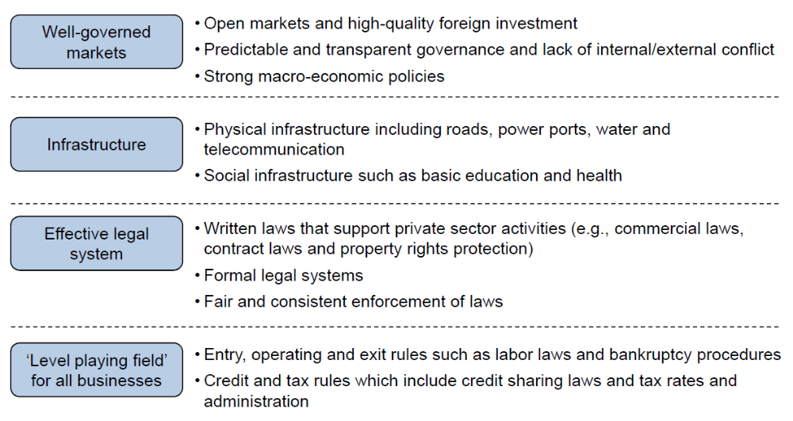
HEADWINDS TO EFFICIENT
IMPACT INVESTING MARKETS
Are there…?
-Dalberg
Notes:
When we dug into the issue we found… headwinds
+ Local legal, monetary, and trade improvements are hindering success…
+ Effective government is the solution here…

Slide 32

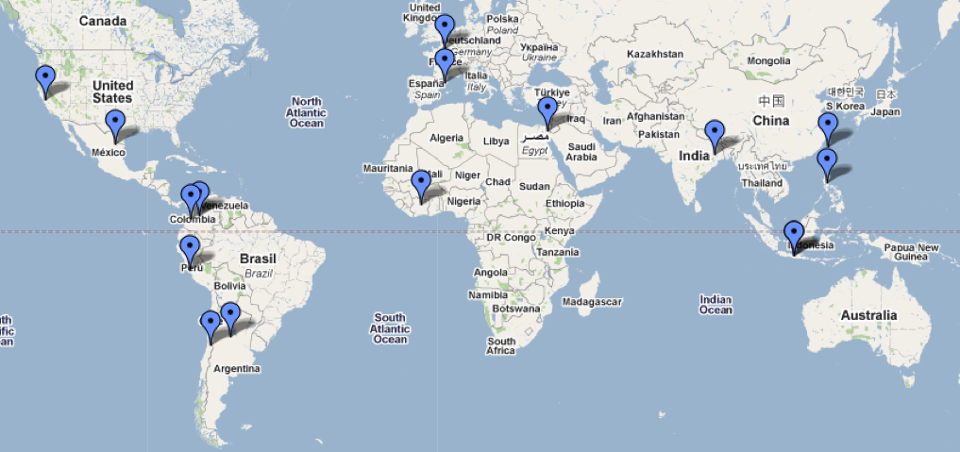

ESSEC
ESADE
Tecnologico de Monterrey
Israel Venture Network
Fu Jen Catholic University
XLRI Jamshedpur
CK Prahalad
Ateneo de Manila University
Pontificia Universidad Javeriana, Cali
Pontificia Universidad Javeriana, Bogota
CERAP
East Africa
ATMI Surakarta
Universidad del Pacifico
Universidad Catolica de Cordoba
Un Techo Para Mi Pais
Jesuit Partner Institution
Mission-Aligned Partner
Launched at IAJBS plenary in July
MOUs in place: XLRI, Ateneo, CK Prahalad, ESADE
GSBI Network Working Group met October 19-21

Slide 33
GSBI PRODUCT LINES
Frugal supports all stages
Capital needs increase with development stage
10⁴
GSBI ONLINE
1000s PER YEAR
10³
GLOBAL NUMBER: QUALIFIED SOCIAL ENTREPRENEURS
GSBI NETWORK
100s PER YEAR
GSBI AT SCU
16-20 PER YEAR
10²
ACCELERATOR
2-3
10¹
ASPIRING
EMERGING
ADVANCED
DEVELOPMENT STAGE OF SOCIAL ENTERPRISE
Notes:
Different product lines to help different

Slide 34

August 23rd, 2012

Slide 35
THANK YOU!
QUESTIONS?
WWW.SCU.EDU/SOCIALBENEFIT
jkohler@scu.edu

