Slide 1
Promising Model for Promoting Quality Research and Education in Africa:
Regional Initiative in Science and Education ( RISE ) Model
Africa Forum on Science, Technology and Innovation
Nairobi, Kenya, 1–3 April 2012
Prof. Mohamed H.A. Hassan

Slide 2
RISE Goals: Three interrelated goals
Increase number and quality of academic staff in African universities: training and retaining a new generation of problem-solving S&T research leaders in African universities
Build sustainable capacity of African universities in providing quality postgraduate education to young talented African scientists
Build Africa’s capacity to apply STI to generate wealth and solve real-life problems

Slide 3
RISE Networks
Selection of topics
Selection and nature of networks
Funding and administration
Early results
Benefits
Expansion and sustainability

Slide 4
Selection of Topics
Academics
THEMES
Industrialists
Policy -Makers

Slide 5
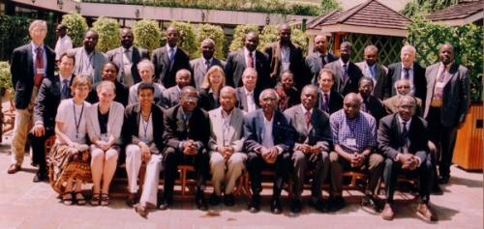
Selection of Topics
Planning workshop (Nairobi 2007): consultation with various stakeholders

Slide 6
Selection of Topics
Materials science
Chemistry ( natural products and biochemistry )
Mathematics ( modeling )
Informatics, instrumentation, software engineering
Energy ( Renewable )
Water ( Management and Quality )

Slide 7
RISE Networks
Selection of priority areas
Selection and nature of networks
Funding and administration
Early results
Benefits
Expansion and sustainability

Slide 8
Selection and nature of networks
Open call for proposals in selected themes
Merit-based, competitive selection by international committees of renowned scientists, in two stages : concept notes and fully developed proposals
Eligible proposals are networks of competent research and training institutes: each involving at least 3 different universities in 3 different countries in sub-Saharan Africa
Each selected network must have a clear strategy for training a good number of MSc and PhD students as well as a joint research plan for academic staff and students. Each network member (node) is expected to take part in implementing the strategy

Slide 9
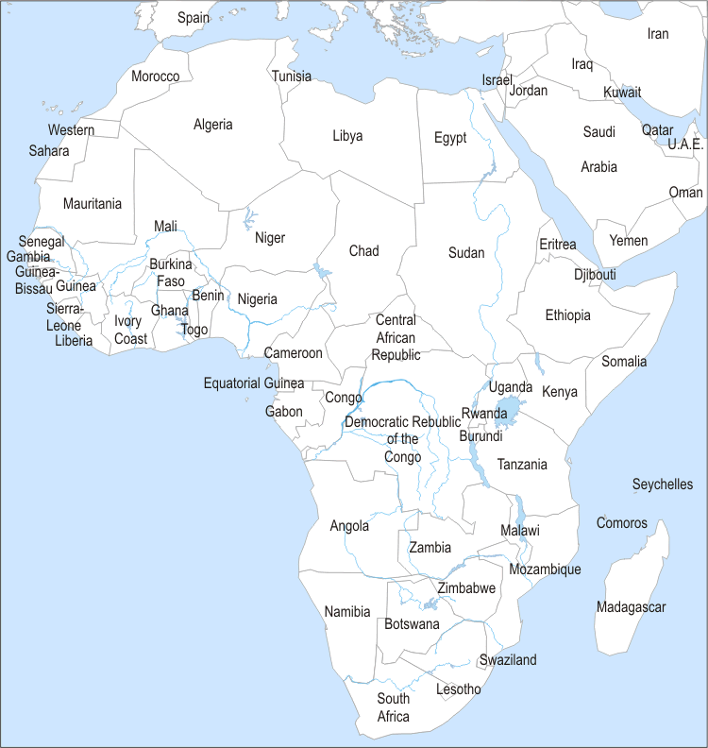
48 concept proposals
involving 29 countries*
12 full proposals
involving 14 countries*
*Symbols indicate countries, not specific cities.

Slide 10
5 Networks selected:
AMSEN
(SA, Botswana, Kenya, Namibia, Nigeria)
AFNNET
(Uganda, Kenya, Tanzania)
SABINA
(Malawi, Namibia, Tanzania, SA)
SSAWRN
(SA, Botswana, Mozambique, Uganda)
WIORISE
(Tanzania, Mozambique, SA)
(Symbols indicate countries,
not specific cities.)

Slide 11
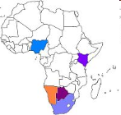
RISE - AMSEN: African Materials Science and Engineering Network
Academic Director:
Lesley Cornish, University of the Witwatersrand, South Africa
Other participating institutions:
  University of Namibia
  University of Nairobi, Kenya
  Federal University of Technology, Akure, Nigeria
  University of Botswana
AMSEN focuses on developing the skills
in materials science and engineering
needed to develop and add value
to the extensive mineral deposits in southern Africa.

Slide 12
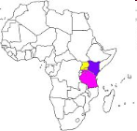
RISE - AFNNET:
African Natural Products Network
Academic Director:
John David Kabasa, Makerere University, Uganda
Other participating institutions:
  University of Nairobi, Kenya
  Sokoine University, Tanzania
AFNNET seeks to develop Africa’s rich
biodiversity into a natural products industry
of social and economic significance through coursework and research in engineering, biochemistry, environmental science, pharmacology, economic development, and nutrition.

Slide 13
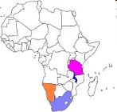
RISE - SABINA: Southern African Biochemistry and Informatics Network
Academic Director:
John Saka, University of Malawi
Other participating institutions:
  University of Namibia
  University of Dar es Salaam, Tanzania
  University of Pretoria, South Africa
  University of the Witwatersrand, South Africa
  CSIR, South Africa
  Tea Research Foundation of Central Africa, Malawi
SABINA works with natural products that have the potential to increase food security, public health, and value-added exports.
Its research emphasis is on biochemistry and chemistry
of natural products.

Slide 14
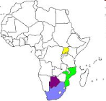
RISE - SSAWRN: Sub-Saharan Africa Water Resources Network
Academic Director:
Denis Hughes, Rhodes University, South Africa
Other participating institutions:
  Eduardo Mondlane University, Mozambique
  University of Botswana
  Makerere University, Uganda
SSAWRN focuses on the most pressing water issues of sub-Saharan Africa, including rising use, declining quality, insufficient research and teaching capacity, inadequate weather stations, and the likelihood of increased variability of water supplies associated with future climates.

Slide 15
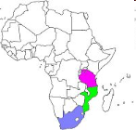
RISE - WIO: Western Indian Ocean Regional Initiative
Academic Director:
Margareth Kyewalyanga, University of Dar es Salaam, Tanzania
Other participating institutions:
  Eduardo Mondlane University, Mozambique
  University of Cape Town, South Africa
  University of Mauritius
WIO provides research and training in skills associated with the utilization of coastal and marine resources and protection of the coastal and marine environment.

Slide 16
RISE Networks
Selection of priority areas
Selection and nature of networks
Funding and administration
Early results
Benefits
Expansion and sustainability

Slide 17
Funding and administration
Funded by Carnegie Corporation US$5M grant 2011-2013
Leveraged US$2M from other sources
Each network receives US$800K over three years; majority for PhD/MSc training
Each network has its own secretariat at one member university; substantial autonomy on academic, administrative and financial management
Coordination and general administration provided by Science Initiative Group (SIG ) at IAS , Princeton.
Africa–based secretariat: Agreement signed with AUST- Abuja

Slide 18
RISE Networks
Selection of priority areas
Selection and nature of networks
Funding and administration
Early results
Benefits
Expansion and sustainability

Slide 19
Early results
Completed: 20 MSc; 6 PhD
Currently enrolled: 40 MSc; 59 PhD
Workshop proceedings, conference papers, journal publications
At least 5 patent applications submitted

Slide 20
Early results
 | Currently Enrolled |  | Completed
 | MSc | PhD | MSc | PhD | Total
AMSEN | 7 | 14 | 3 | 0 | 24
AFNNET | 12 | 13 | 8 | 4 | 37
SABINA | 4 | 9 | 3 | 1 | 17
SSAWRN | 11 | 13 | 1 | 1 | 6
WIO | 6 | 10 | 5 | 0 | 21
Totals | 40 | 59 | 20 | 6 | 125

Slide 21
RISE Networks
Selection of priority areas
Selection and nature of networks
Funding and administration
Early results
Benefits
Expansion and sustainability

Slide 22
Benefits
Acquisition of major scientific instrumentation with pooled funds
Improved collaboration among universities; promoting a culture of co-supervision and quality assurance.
Establishment of joint MSc curriculum in natural products involving 3 universities ( Kenya, Tanzania, Uganda )
Encouraging stronger institutions to support weaker ones
Enabling students to gain skills not available at home and strengthening their capacity to conduct top quality research in an African environment

Slide 23
RISE Networks
Selection of priority areas
Selection and nature of networks
Funding and administration
Early results
Benefits
Expansion and sustainability

Slide 24
Expansion and sustainability
More universities per network
More networks ( biological sciences )
  Competitively selected
  Targeted fields
  Targeted geographic areas (e.g. west and north Africa)
Links with non-African universities
  Visiting professors
  Students and staff exchange
Product development and commercialization
African co-secretariat: AUST-Abuja
Financial support: African and non-African governments, AfDB, World Bank, AU, …

Slide 25
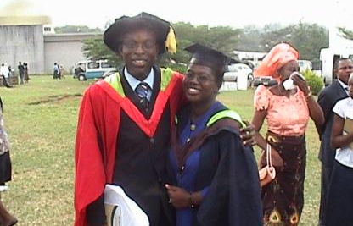

Thank you
Mohamed H.A. Hassan
hassan@ictp.it
Further information: www.ias.edu/sig

